Slide 1
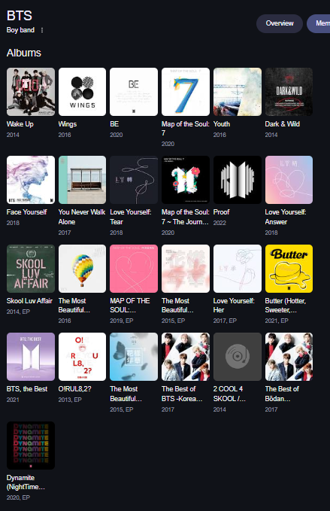
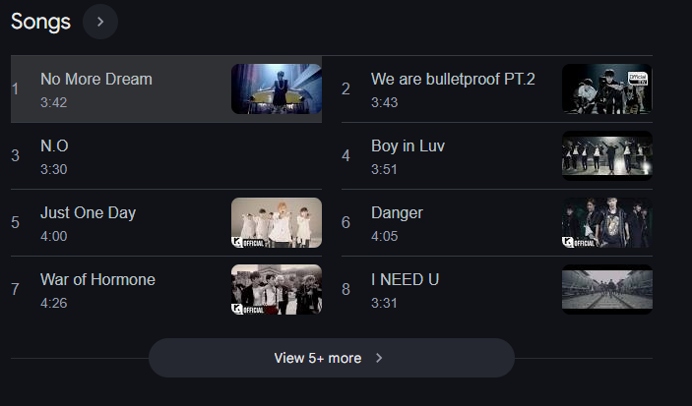
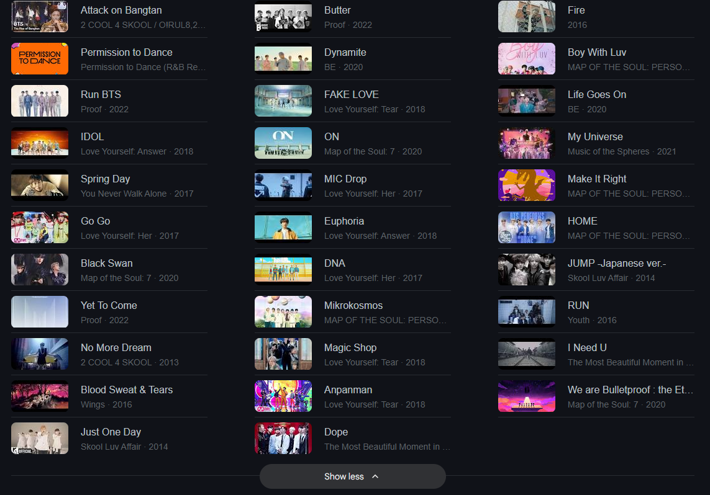
Artists
Features
Pricing
Log-In

Slide 2









Dynamite
Intro A
Intro B
Verse A
Beats
Chorus
Verse B
Bridge
Break
Verse C
Groove
Home
RM
Jungkook
V
Jimin
Suga
All
RM
J-hope
Auto
V
Suga
Jungkook
All
Jimin
RM
J-hope
RM
Register
RM
Jungkook
V
Jimin
Suga
All
RM
J-hope
Coin
V
Suga
Jungkook
All
Jimin
RM
J-hope
RM
Download

